Slide 1

robert smith FOR REFERENCE ONLY
Robert is a Regional Sales Director who travels 4 - 8 times each month for work. He has a specific region in which he travels, and he often visits the same cities and stays at the same hotel with specific requirements. He is frustrated by the fact that no matter how frequently he takes similar trips, he spends hours of his day booking travel. He expects her travel solutions to be as organized as he is.
To spend less time booking air tickets
To spend less time booking accommodations with same requirements
To narrow options quickly
Spent too much time searching the web for options
Time taken to do the necessary bookings - too long
Does not like repetitive tasks
“ Looking for an app that will simplify and speed up the planning of my numerous business trips.”
Organized
Practical
Sociable
Expedia
Trivago
Agoda
38
Regional Sales Director
Single
Singapore
Frequent Flyer

Slide 2
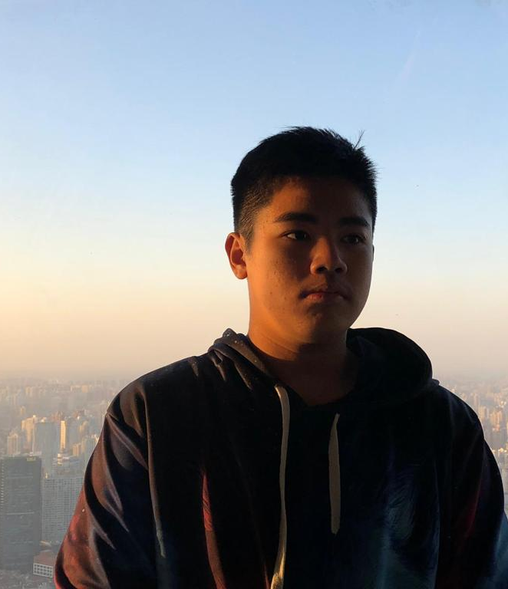
Ferturb bom
Ferturb is a marine biologist who studies the evolution and characteristics of penguins and works part time at the Singapore zoo taking care of penguins. Every day after work, it has become a habit for him to whip out his phone and listen to music for his 30-minute bus ride home the moment he steps out of his workplace building. Despite already cultivated this habit, he still faces frustrations as he cannot pin his frequently-listened playlist on the home page where he can directly be redirected to the specific playlist. Instead, 6 playlists are always grouped together on the main page and are not always fixed in their places but are always mixed up. Hence, natural human error occurs, and he will always press the playlist at that location where he thinks is his favourite playlist until he gets used to the random shuffling positions of playlists and accepts that the they are not always fixed in the same locations.
To be able to start playing his favourite playlist of songs within 2-3 clicks of buttons
Cannot pin his favourite playlists on the home page and has to manually go to his library of playlist and select that playlist
Number of playlists on main page are too many and quite small, and are not always fixed in their locations, always mixed up around the few playlist displayed on the top section of the home page.
These errors causes Ferturb to spend more time looking at his phone trying to get to the playlist and play the song – accidents may occur such as car accidents or bicycle accidents or bump into people as not paying attention on the road.
“I want to use this music app where it is important for me to be able to pin playlists on the home page where I can easily access them even with my eyes closed.”
Outgoing
Sociable
Persevering
VIU
VLive
17
Marine Biologist
Single
Singapore
Passionate about music

